Slide 1
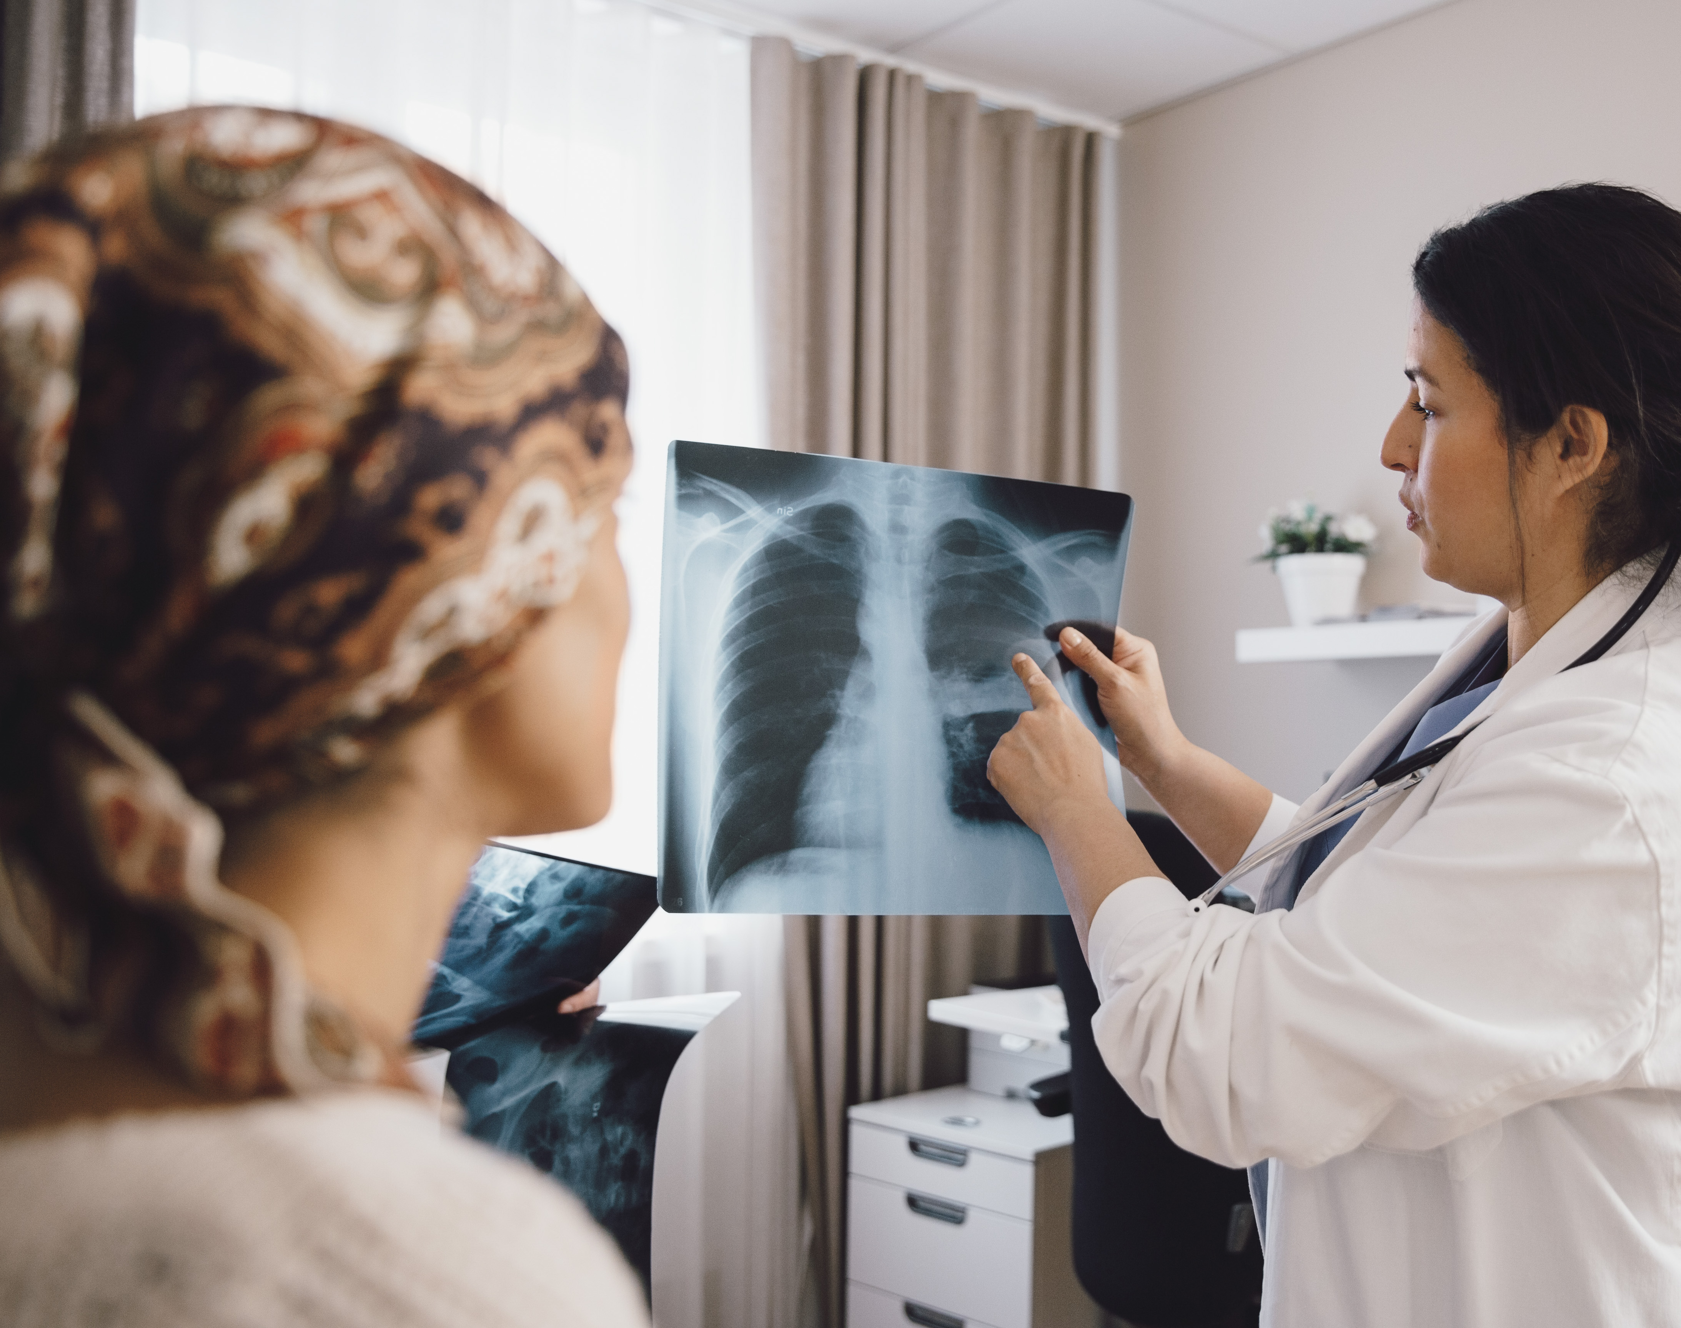
Deep Learning Project: Identifying Pneumonia diagnosis by CNN Classifier
Colleen Jung
May 2024

Slide 2

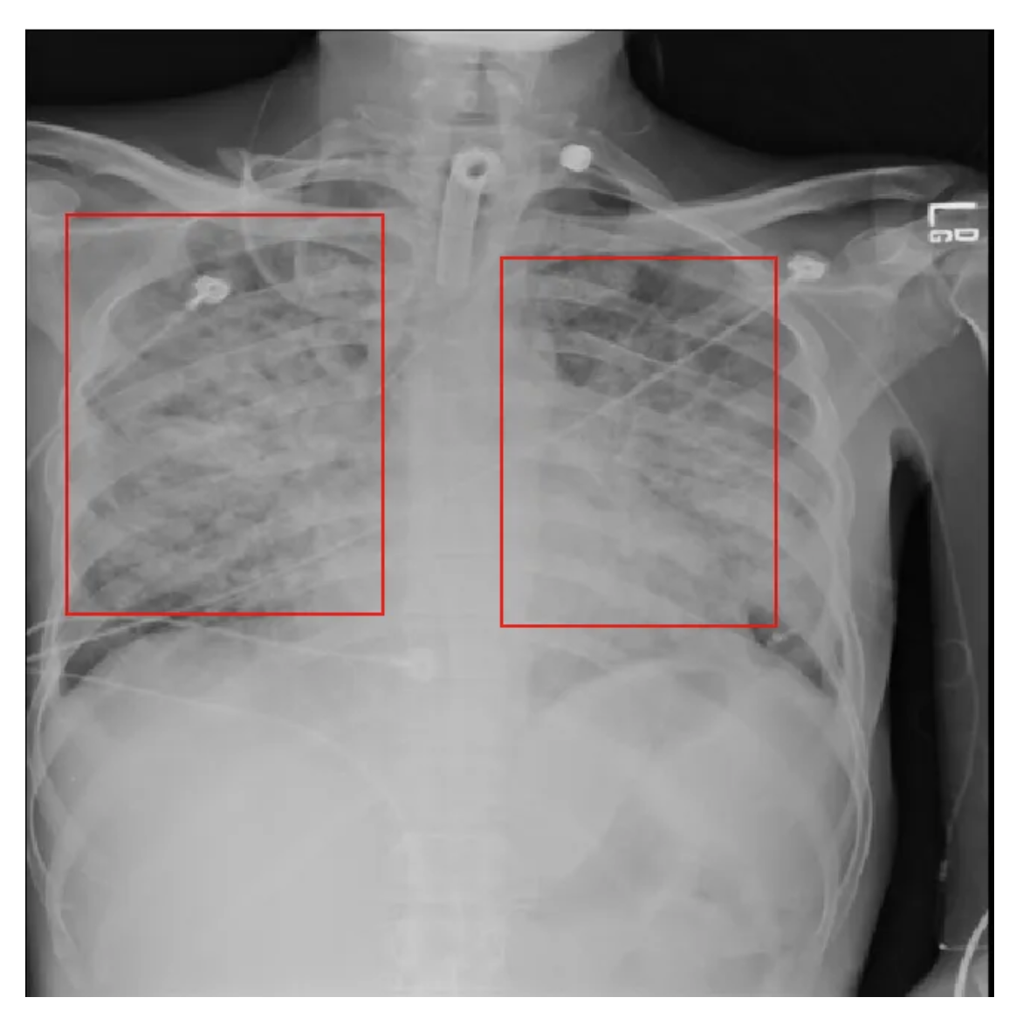
X-ray-based pneumonia diagnosis remains a monumental challenge even for trained and experienced clinicians
Pneumonia
Data Engineering
Results
Model Selection
15% of all deaths of children under
5 years old internationally, are accounted for by pneumonia.
920,000 children under the age of 5 died from the disease in 2015.
While common, accurately diagnosing pneumonia is difficult. It requires review of a chest radiograph (CXR) by highly trained specialists and confirmation through clinical history, vital signs and laboratory exams.
Chest Radiographs Basics
* Black = Air
* White = Bone
* Grey = Tissue or Fluid

Slide 3
Deep learning helps detect potential pneumonia cases
Pneumonia
Data Engineering
Results
Model Selection
Current Problem
Model Benefits
Clinicians are faced with reading high volumes of images every shift. Being tired or distracted clinicians can miss important details in image
Model Accuracy :
Automate initial detection (imaging screening) of potential pneumonia cases and expedite their review
The diagnosis of pneumonia on CXR is complicated due to other conditions in the lungs such as fluid overload (pulmonary edema), bleeding, etc
Model Explainability :
Comparison of CXRs taken at different time points and correlation with clinical symptoms and history are helpful in making the diagnosis

Slide 4
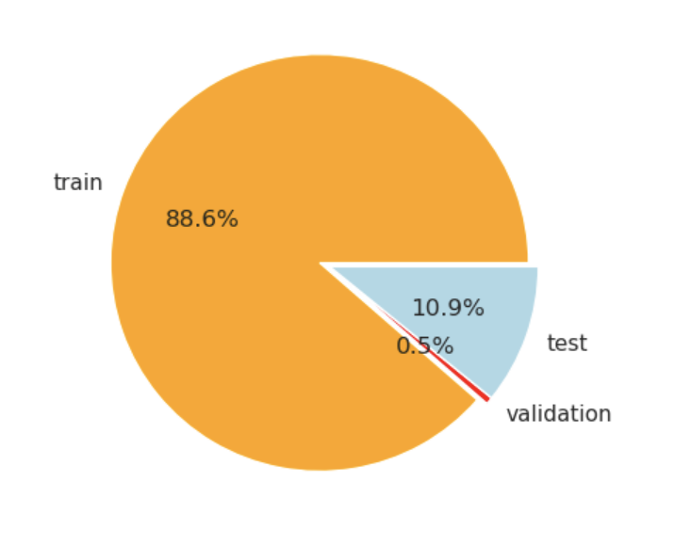
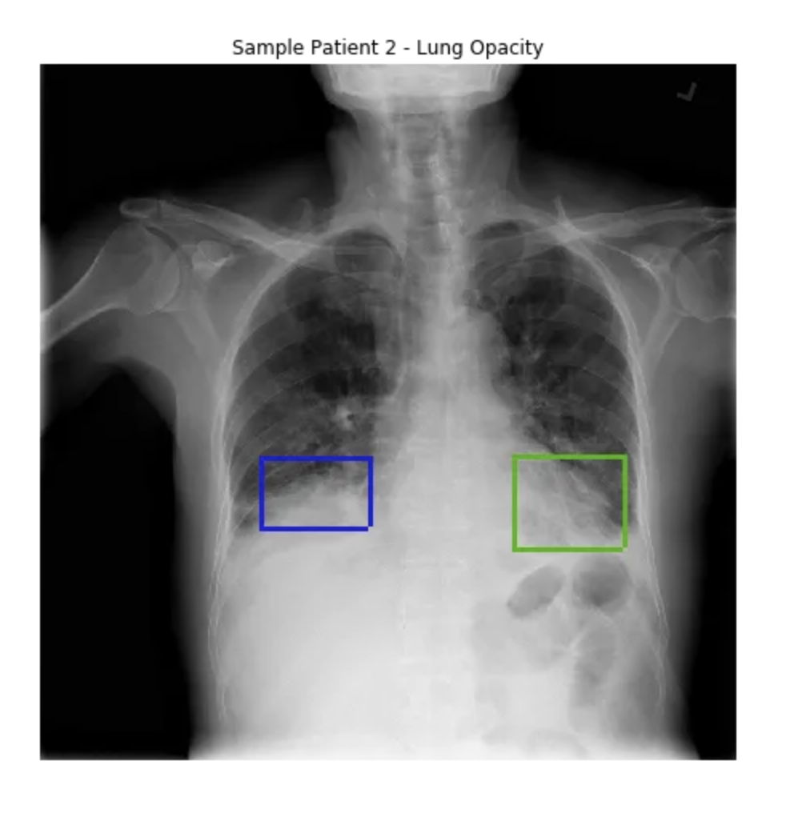
Chest xray Image data
Pneumonia
Data Engineering
Results
Model Selection
Pie chart
Sample image Data
Chest_xray Image Data
Num. Observations: 5.8K
No. of Features: 3
No. of Sub-Features: 2
Sample Features: train, test, validation
Sample Sub-Features: Normal, Pneumonia
Pneumonia usually manifests as an area or areas of increased lung opacity on CXR.

Slide 5
Feature Engineering: CNN Layers
Pneumonia
Data Engineering
Results
Model Selection
CNN Layers
Regularization
flatten
Dropout(30%)
Dense (activation='relu')
Dropout(20%)
Dense (activation='sigmoid’)
Image data
VGG16 Base Model
 | L2 Regularization | Dropout
Implementation | kernel_regularizer=l2(0.05) | Dropout(0.3->0.2)
Purpose | Encourage the weights to move towards zero but not exactly zero. This encourages the model to keep the weights small, making the model simpler and less likely to overfit on the training data | a dropout rate of 30% after the Flatten layer and 20% after a dense layer, the network becomes less sensitive to the specific weights of neurons

Slide 6
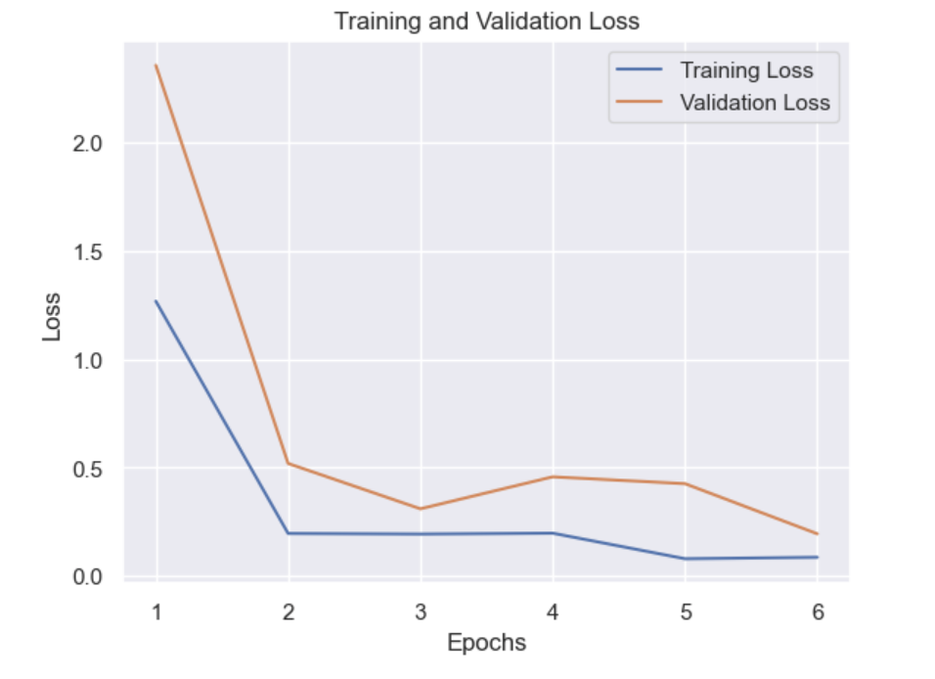
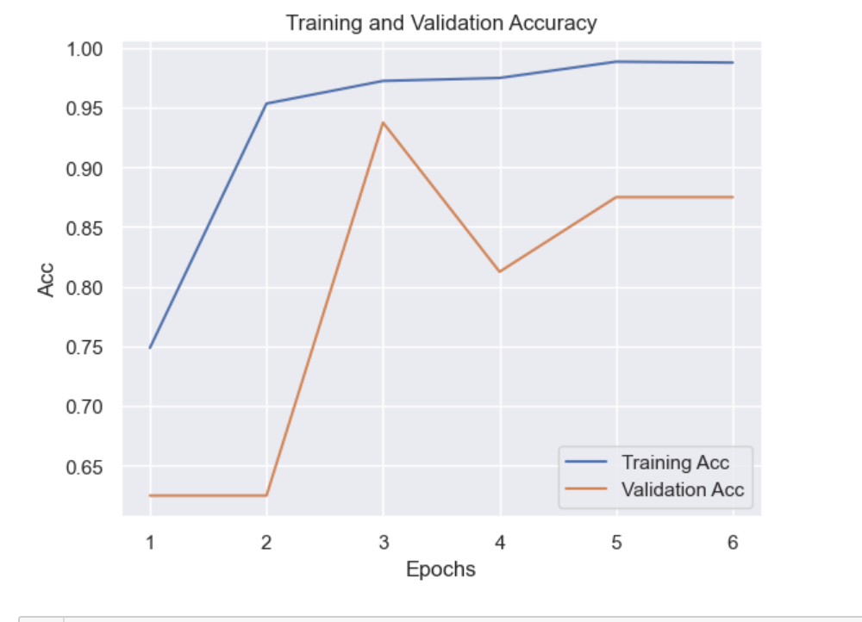
CNN Model scored 93.7% in accuracy, competent to diagnosis Pneumonia
Pneumonia
Data Engineering
Results
Model Selection
The loss of the training set decreases continuously over epochs, whereas its accuracy increases
For validation data, the lowest loss for the test set happened at epoch 6 at 0.1935, while the accuracy was at its peak at epoch 3 at 0.9375.

Slide 7
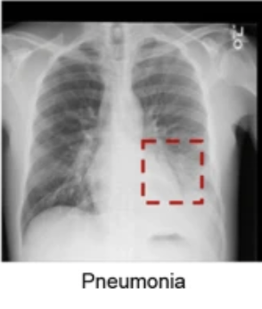
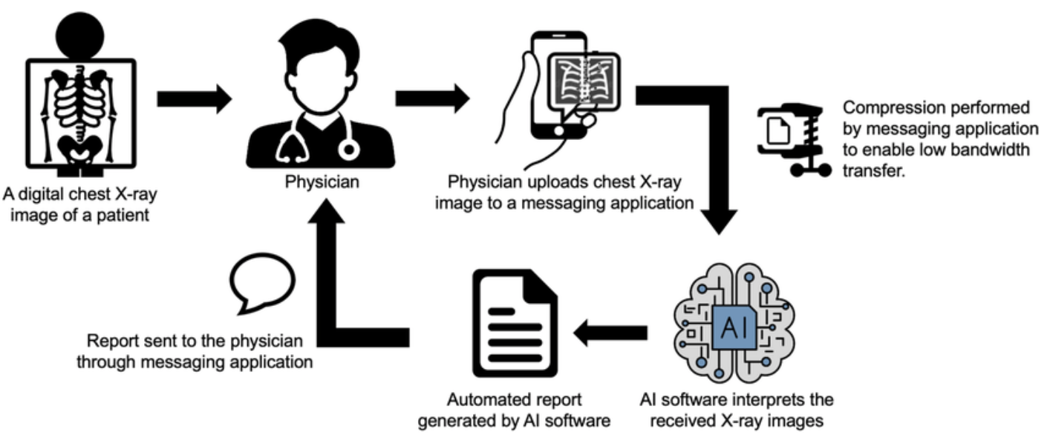

AI aided Diagnosis of Xray images
Pneumonia
Data Engineering
Results
Model Selection
AI Report
Schematic drawing of an AI aided Diagnosis
Example AI Report: This image is 100.000 percent P N E U M O N I A
Source

Slide 8
Future Work
Pneumonia
Data Engineering
Results
Model Selection
$1.2M to acquire computational resources, high-quality data and operational runway for the next 6M
Data Improvement
Model Tuning
Platform Design
Pilot Run
Enhanced Data Collection: Collect more varied data from different demographics and X-ray equipment to improve the robustness and applicability of the model
Experiment with Different Architectures: Try different CNN architectures or newer models that might offer better performance or efficiency, like EfficientNet or ResNets
User-Friendly Interface: Develop a more intuitive user interface for non-technical users, such as radiologists, to facilitate easier adoption of the technology
Integration with Hospital Systems
Clinical Trial: Conduct a pilot study in a clinical setting to gather real-world data on the model's performance and acceptance among healthcare professionals

